Slide 1

IBM CASE STUDY
By: Swagat Pruseth

Slide 2


OBJECTIVES
Background
Business Model
Key Driver of Success
Competitors
Revenue by Region
Revenue Breakdown
Brief Summary
Questionnaire
Bibliography

Slide 3
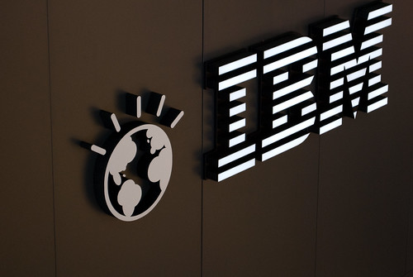
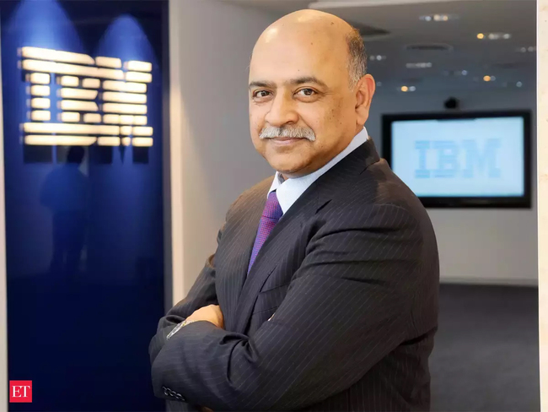
BACKGROUND
The International Business Machines Corporation (using Ticker IBM), nicknamed Big Blue, is an American multinational technology corporation headquartered in Armonk, New York and is present in over 175 countries. IBM is the largest industrial research organization in the world, with 19 research facilities across a dozen countries, and held the record for most annual U.S. patents generated by a business for 29 consecutive years from 1993 to 2021. Current CEO position held by Arvind Krishna.
Rev. $60.53 Billion (as of 2022)
SIC Code: 7373, which corresponds to the category "Computer Integrated Systems Design."
This Photo by Unknown Author is licensed under CC BY-SA

Slide 4
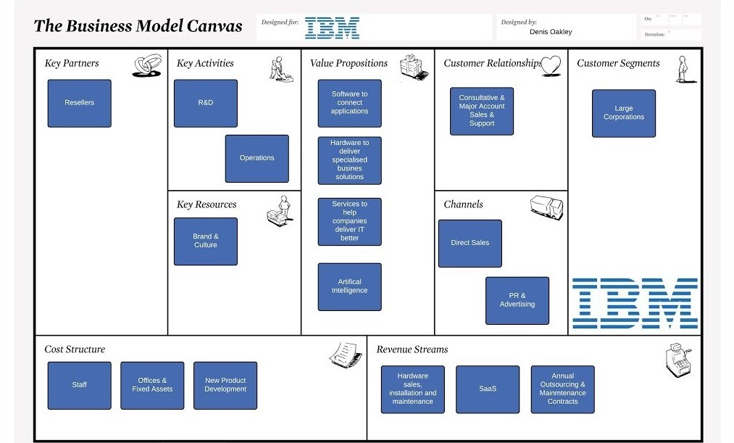
BUSINESS MODEL CANVAS: IBM

Slide 5
KEY DRIVERS OF SUCCESS
Innovation and Research
Diversified Portfolio
Global Presence
Strategic Partnerships
Client-Centric Approach
Focus on Emerging Technologies
Commitment to Sustainability
Adaptability and Transformation
Talented Workforce
Strong Leadership

Slide 6
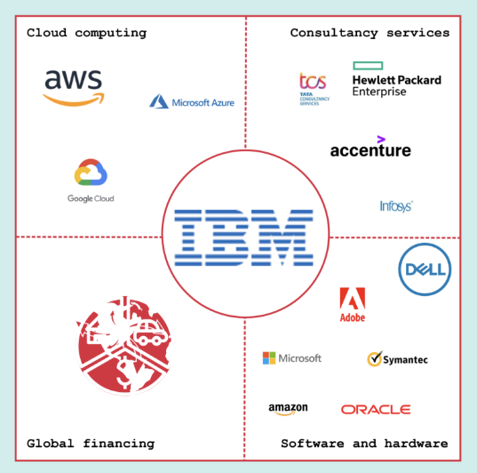
GLOBAL Competitors

Slide 7
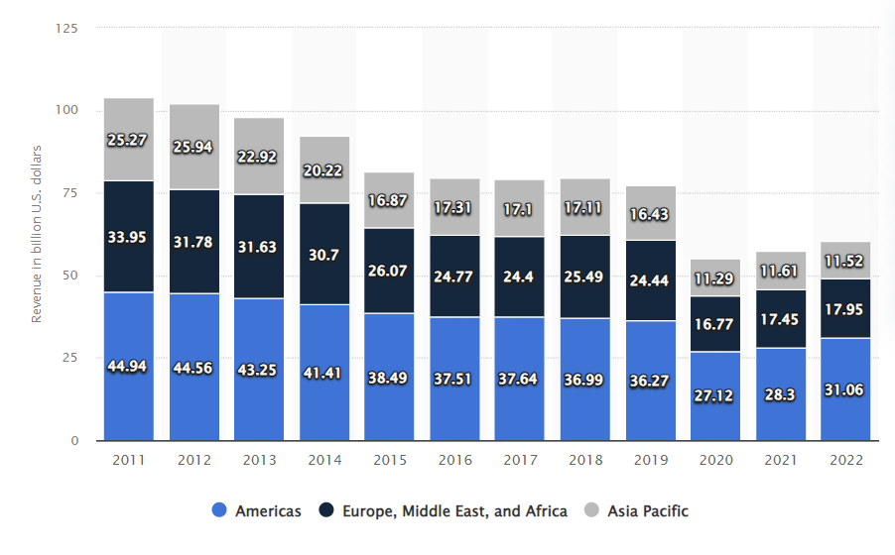
IBM revenue worldwide by region

Slide 8
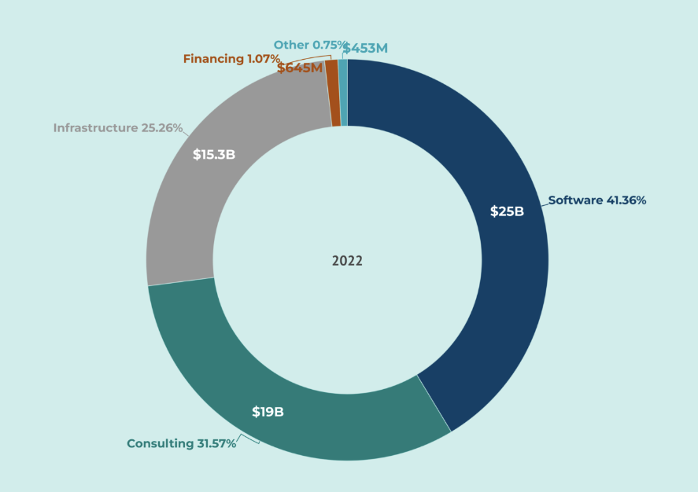
IBM revenue breakdown on services offered

Slide 9
CASE study: Generating higher value at IBM. Case summary
The case study offers a thorough examination of IBM's financial results, strategic direction, and historical evolution. It begins with a reflection on IBM's historical progression from a tabulating solutions provider to a major force in information technology. The transformation journey encompasses pivotal moments under influential leaders such as Thomas J. Watson, Louis V. Gerstner, Jr., and Samuel J. Palmisano. The case study also puts IBM's strategy changes—such as its emphasis on network computing and the fusion of software and services—into context. The paper goes into additional detail about IBM's financial performance, especially with regard to its long-term EPS projections and the role that its financial model plays in explaining the company's goals and strategy to potential investors. It also covers the effects of IBM's cash distribution practices, including dividends and share

Slide 10



Questionnaire

Slide 11
Why did IBM prepare and publicly announce the 2010 EPS Roadmap in May 2007?
IBM prepared and publicly announced the 2010 EPS Roadmap in May 2007 to provide investors and stakeholders with a clear and transparent view of the company's long-term financial objectives and strategic direction. The roadmap was intended to communicate IBM's commitment to achieving specific earnings per share targets by 2010, with a goal of reaching $11.00 EPS from a baseline diluted EPS figure of $6.11 in 2006. This initiative aimed to build confidence in the company's ability to drive sustainable top and bottom-line growth, as well as to provide clarity on the strategies and initiatives that would enable IBM to meet its financial goals.

Slide 12
How would you assess IBM’s financial performance before (from 2004-2006) and after (from 2007-2009) the Roadmap Announcement? Hint: Why and how did the ROE and the cash flow changed in the 10 years?
IBM's financial performance before the Roadmap Announcement (from 2004-2006) and after (from 2007-2009) showed significant improvements. Before the announcement, IBM experienced a rise in leverage ratio from 43% to 63%, distributing $140 billion of cash to shareholders through dividends and share repurchases. The company's financial performance from 2006 to 2009 demonstrated substantial growth, with revenues increasing by 5% to $95.8 billion and net income rising by 41% to $13.4 billion. This improvement was attributed to efficiency enhancements, margin improvements, and a more profitable business mix due to acquisitions, divestitures, and organic growth. Additionally, the number of shares outstanding decreased due to buybacks, leading to a rise in diluted EPS from $6.05 in 2006 to $10.01 in 2009. The financial model underlying the roadmap included cash flow generation and distribution through dividends and share repurchases, contributing to the company's improved financial performance. Overall, the financial performance before and after the roadmap announcement showcased IBM's successful execution of its strategic initiatives, resulting in enhanced profitability and shareholder value.

Slide 13
Was the 2010 Roadmap successful?
In general, the 2010 Roadmap was effective in accomplishing its goals. Analysts and investors embraced the roadmap, which sought to clarify internal goal-setting and give clarity for investors by articulating both strategic and tactical aims. It provided a clear roadmap for IBM to reach its 2010 EPS target of $11.00, and the business made considerable strides in that direction. The roadmap also showed IBM's dedication to long-term value generation and offered transparency on the company's capital allocation approach.
Between 2010 and 2013, IBM's financial performance was in line with the stated objective; sales were unchanged, but net income increased by 11% and operating profit by 20%. Furthermore, the company's operational, net, and gross margins all increased, and the quantity of outstanding shares kept rising.

Slide 14
How does the 2015 Roadmap differ from the 2010 Roadmap?
There are numerous significant differences between the 2010 and 2015 Roadmaps. The main purpose of the 2010 Roadmap, which was first developed as a communications tool to explain strategic and tactical goals to investors, was to hit the $11.00 EPS target by the year 2010. It was created top-down and utilized internally for goal-setting, offering a perspective that extended beyond the upcoming quarter. Every business executive who was responsible for outcomes owned the roadmap, which was an expression of IBM's business strategy. On the other hand, the 2015 Roadmap was unveiled during the investor briefing in May 2010 and was created from the bottom up. It was predicated on anticipated 2010 financial performance, with a minimum operational profit per share target for 2015.

Slide 15
Has the Roadmap been successful until May 2014?
IBM's financial performance from 2010 to 2013 showed progress towards the stated goal, with revenues remaining flat, net income increasing by 11%, and operating profit rising by 20%. The company's gross, operating, and net margins improved, and the number of shares outstanding continued to decrease due to share repurchases. Operating EPS rose from $11.67 per share in 2010 to $16.28 in 2013, representing a 40% increase in three years. However, the first quarter of 2014 showed relatively weak financial results, with a decrease in net income and total revenues. In conclusion, the success of the roadmap until May 2014 was mixed, with some progress towards the EPS target but also challenges and skepticism from analysts.

Slide 16
What should CEO and CFO do as of May 2014?
As of May 2014, the CEO and CFO of IBM should continue to focus on the company's transformation strategy and its goal of achieving EPS of at least $20.00 by 2015. Despite reporting relatively weak financial results for the first quarter of 2014, the leadership team, including CEO Virginia Rometty and CFO Martin Schroeter, reaffirmed the company's plans to transform itself and meet its 2015 EPS target. The CFO assured analysts that the challenges were being addressed and that the firm was still on track to achieve its EPS goal. Given the company's history of strong financial performance and its ongoing efforts to address challenges and transform the business, the CEO and CFO should continue to communicate the long-term vision and strategy to investors and stakeholders. They should emphasize the company's commitment to generating higher value, its focus on strategic growth areas such as cloud, big data analytics, social, mobile, and security, and the benefits expected from these actions in the long term.

Slide 17
What should Sofia Johnson recommend to her clients – buy, hold, or sell IBM shares?
Sophia Johnson - equity analyst at Technology Research Group should consider recommending a "hold" on IBM shares to her clients. REASONS: (A) IBM's senior leaders, including CEO Virginia Rometty and CFO Martin Schroeter, have reaffirmed the company's plans to transform itself and achieve EPS of at least $20.00 in 2015. (B) IBM's stock price has experienced fluctuations, with a slight decrease from its all-time high and a recent decline from $192 to $189 per share. It is not a bad dip, so we should hold. (C) Sofia’s peers have issued "hold" recommendations before the investor briefing, and many made only minor revisions

Slide 18


BIBLIOGRAPH
Content:
https://en.wikipedia.org/wiki/IBM : Wikipedia IBM https://www.statista.com/statistics/531138/worldwide-ibm-global-revenue-by-region/ : Statista
Image:
www.Denis-Oakley.com : Denis-Oakley
https://fourweekmba.com/ibm-competitors/ :4weekMBA

Slide 19

Thank you

